Slide 1
Chapter 12
Return, Risk and the Security Market Line
Hillier, Fundamentals of Corporate Finance 4e

Slide 2
Chapter Overview
Expected Returns and Variances
Portfolios
Announcements, Surprises and Expected Returns
Risk: Systematic and Unsystematic
Diversification and Portfolio Risk
Systematic Risk and Beta
The Security Market Line
The SML and the Cost of Capital: A Preview

Slide 3
Expected Returns and Variances

Slide 4
What is an Expected Return
Expected Return
The return on a risky asset expected in the future

Slide 5
Expected Returns and Variances Example
Two equities:
Equity L is expected to have a return of 25 per cent in the coming year.
Equity U is expected to have a return of 20 per cent for the same period.
The return on Equity L, although it is expected to be 25 per cent, could actually turn out to be higher or lower.
What happens if the economy booms? We think Equity L will have a 70 per cent return. If the economy enters a recession, we think the return will be 20 per cent. In this case, we say that there are two states of the economy.
We think a boom and a recession are equally likely to happen, a 50-50 chance of each.

Slide 6
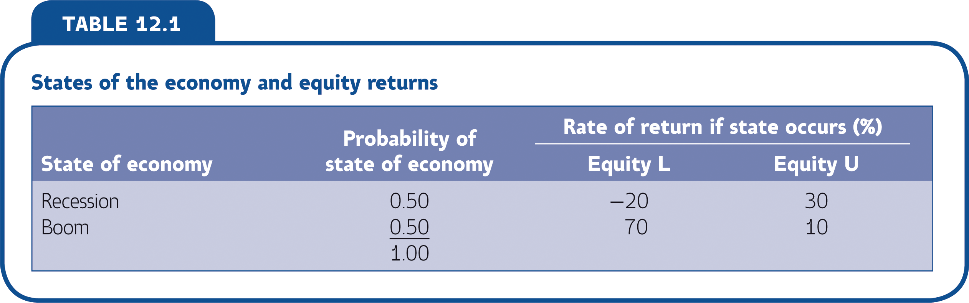

Slide 7
Expected Returns and Variances Example
If you hold Equity U for a number of years, you’ll earn 30 per cent about half the time and 10 per cent the other half. In this case, we say that your expected return on Equity U, E(R_{U}), is 20 per cent:
E(R_{U}) = 0.50 x 30% + 0.50 x 10% = 20%
In other words, you should expect to earn 20 per cent from this equity, on average.
What is the expected return on L?

Slide 8
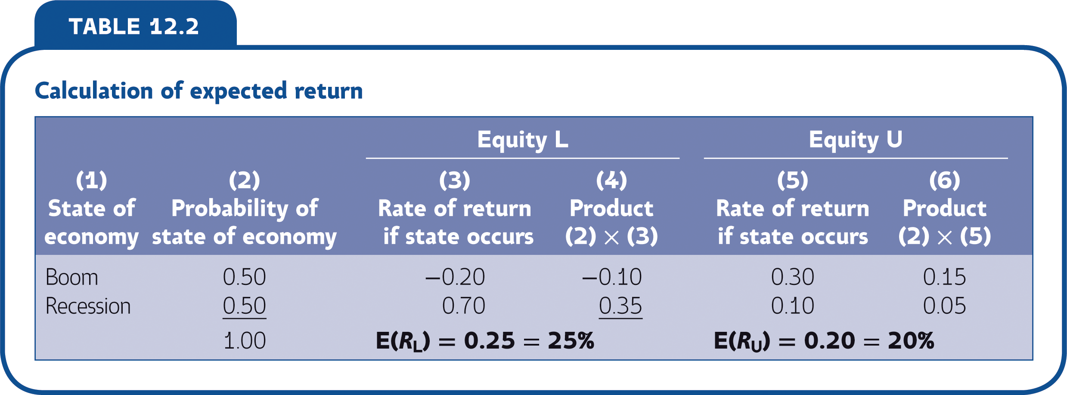

Slide 9
Risk Premium Example
Suppose risk-free investments are currently offering 8 per cent. We will say that the risk-free rate, which we label as R_{f}, is 8 per cent.
Given this, what is the projected risk premium on Equity U?
Risk premium = Expected return – Risk-free rate
= E(R_{U}) – R_{f}
= 20% – 8%
= 12%
Similarly, the risk premium on Equity L is 25% – 8% = 17%.

Slide 10
How to Calculate Variance
Calculating the Variance
Determine the squared deviations from the expected return.
Multiply each possible squared deviation by its probability.
Add these up, and the result is the variance. The standard deviation, as always, is the square root of the variance.

Slide 11
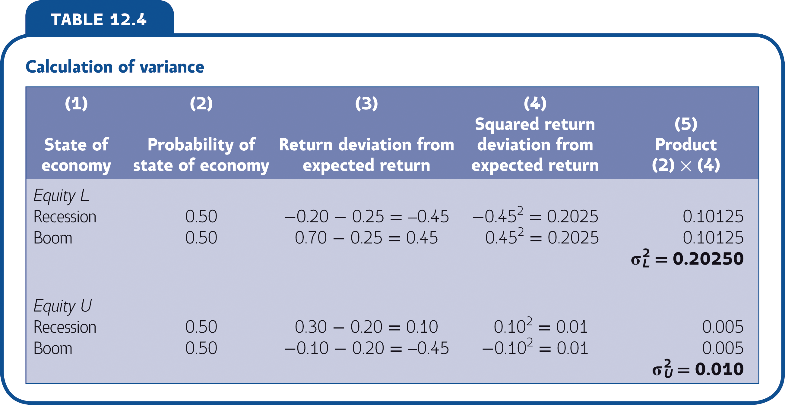

Slide 12
Portfolios

Slide 13
Definitions
Terms
Portfolio
A group of assets such as equities and bonds held by an investor.
Portfolio Weight
The percentage of a portfolio’s total value that is in a particular asset.

Slide 14
Portfolios Example
Let’s return to Equities L and U.
You put half your money in each – portfolio weights are obviously 0.50 and 0.50.
What is the pattern of returns on this portfolio?
The expected return?

Slide 15
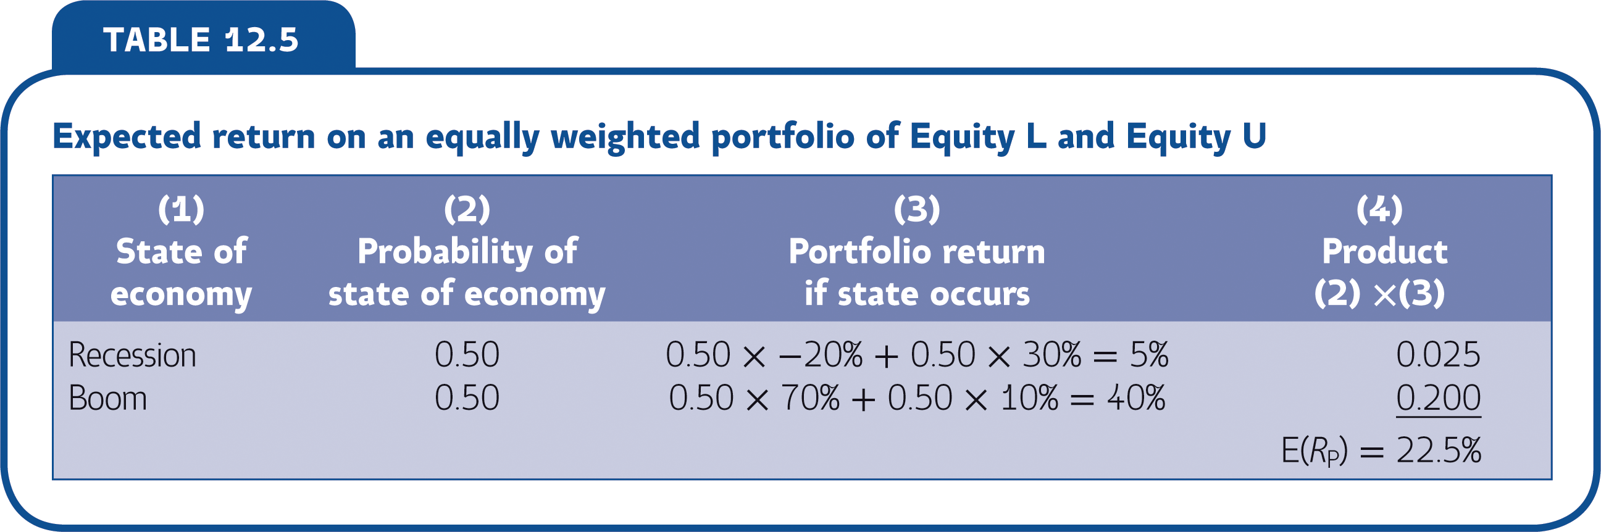

Slide 16
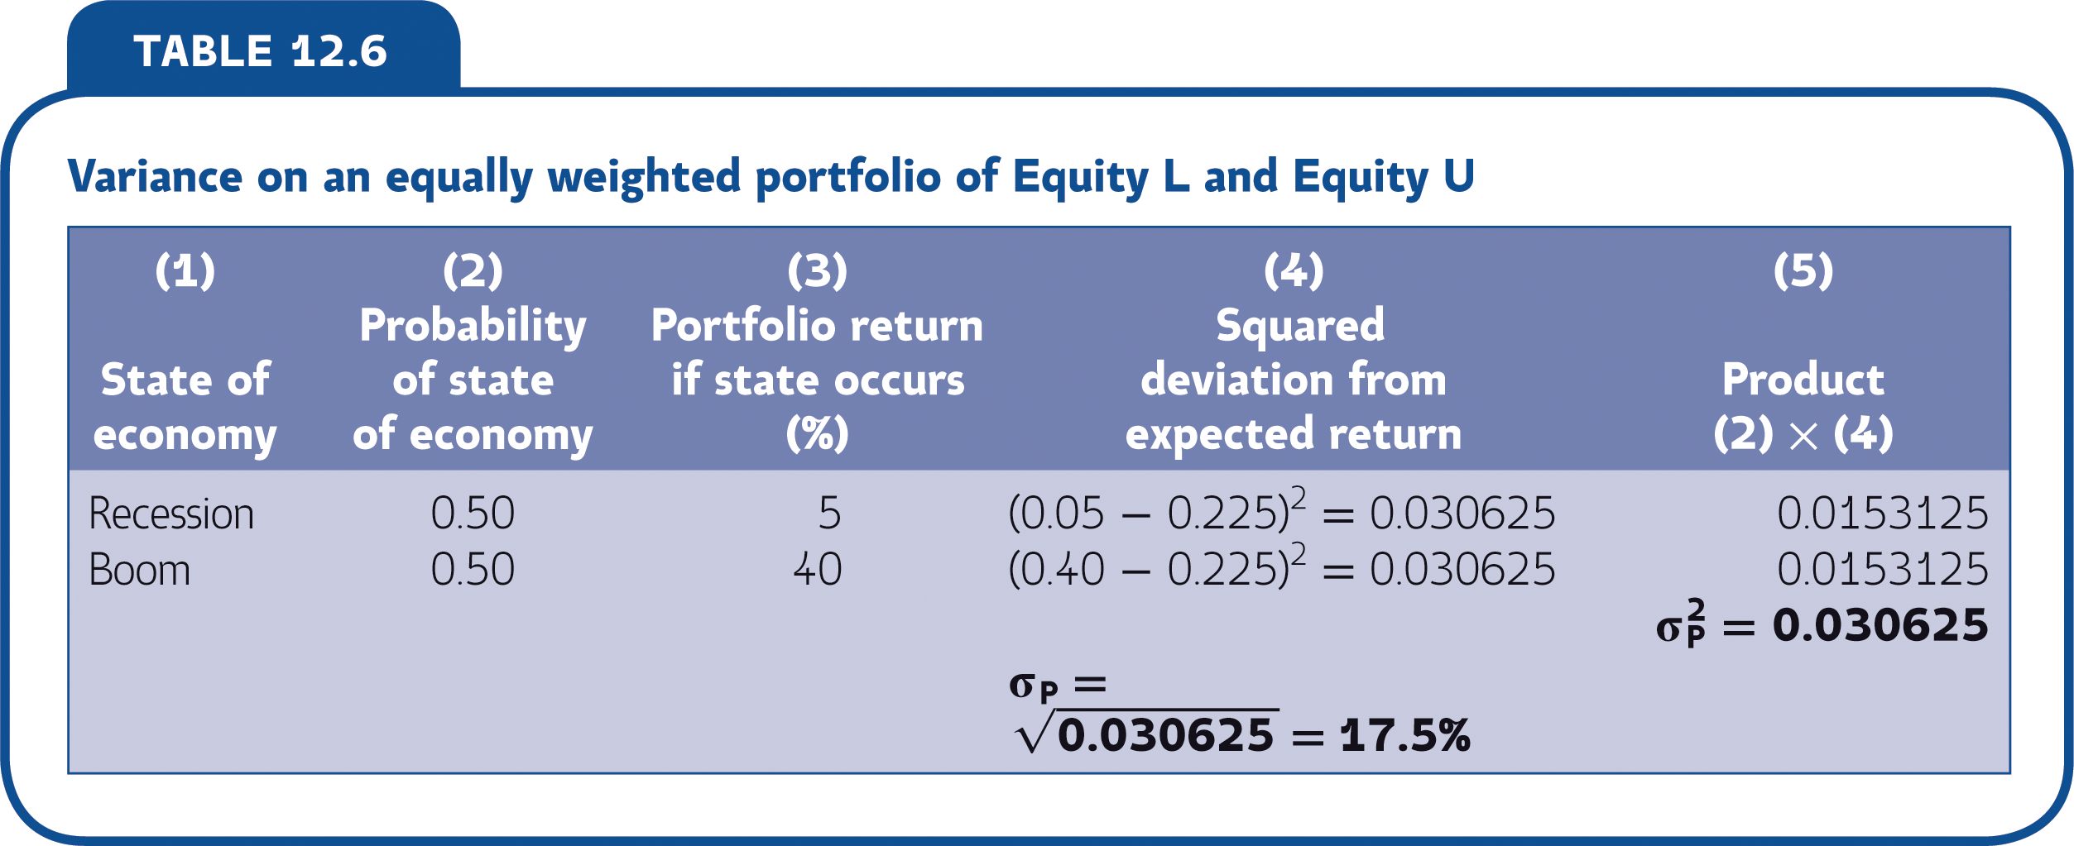
What is the standard deviation of return on this portfolio?

Slide 17
Announcements, Surprises and Expected Returns

Slide 18
Expected and Unexpected Returns
Total return = Expected return + Unexpected return
R = E(R) + U
Where:
R = actual total return in the year
E(R) = expected part of the return
U = unexpected part of the return

Slide 19
Announcements and News
An announcement can be broken into two parts:
The anticipated, or expected, part
The surprise, or innovation
Announcement = Expected Part + Surprise
The expected part of any announcement is the part of the information that the market uses to form the expectation, E(R), of the return on the equity.
The surprise is the news that influences the unanticipated return on the equity, U.

Slide 20
Risk: Systematic and Unsystematic

Slide 21
Definitions
Terms
Systematic Risk
A risk that influences a large number of assets. Also, market risk.
Unsystematic Risk
A risk that affects at most a small number of assets. Also, unique or asset-specific risk.

Slide 22
Systematic and Unsystematic Risk
Actual return breaks down into its expected and surprise components:
R = E(R) + U
Now recognize that the total surprise component, U, has a systematic and an unsystematic component, so:
R = E(R) + Systematic portion + Unsystematic portion
Use the Greek letter epsilon, ε, to stand for the unsystematic portion and the letter m to stand for the systematic part of the surprise. The formula for the total return is:
R = E(R) + U = E(R) + m + ε
The unsystematic portion, ε, is more or less unique to the company. For this reason, it is unrelated to the unsystematic portion of return on most other assets.

Slide 23
Diversification and Portfolio Risk

Slide 24
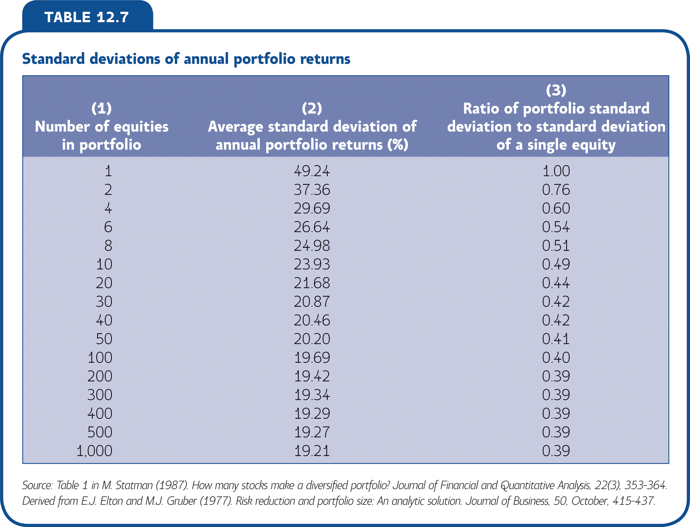

Slide 25
The Principal of Diversification
Spreading an investment across a number of assets will eliminate some, but not all, of the risk

Slide 26
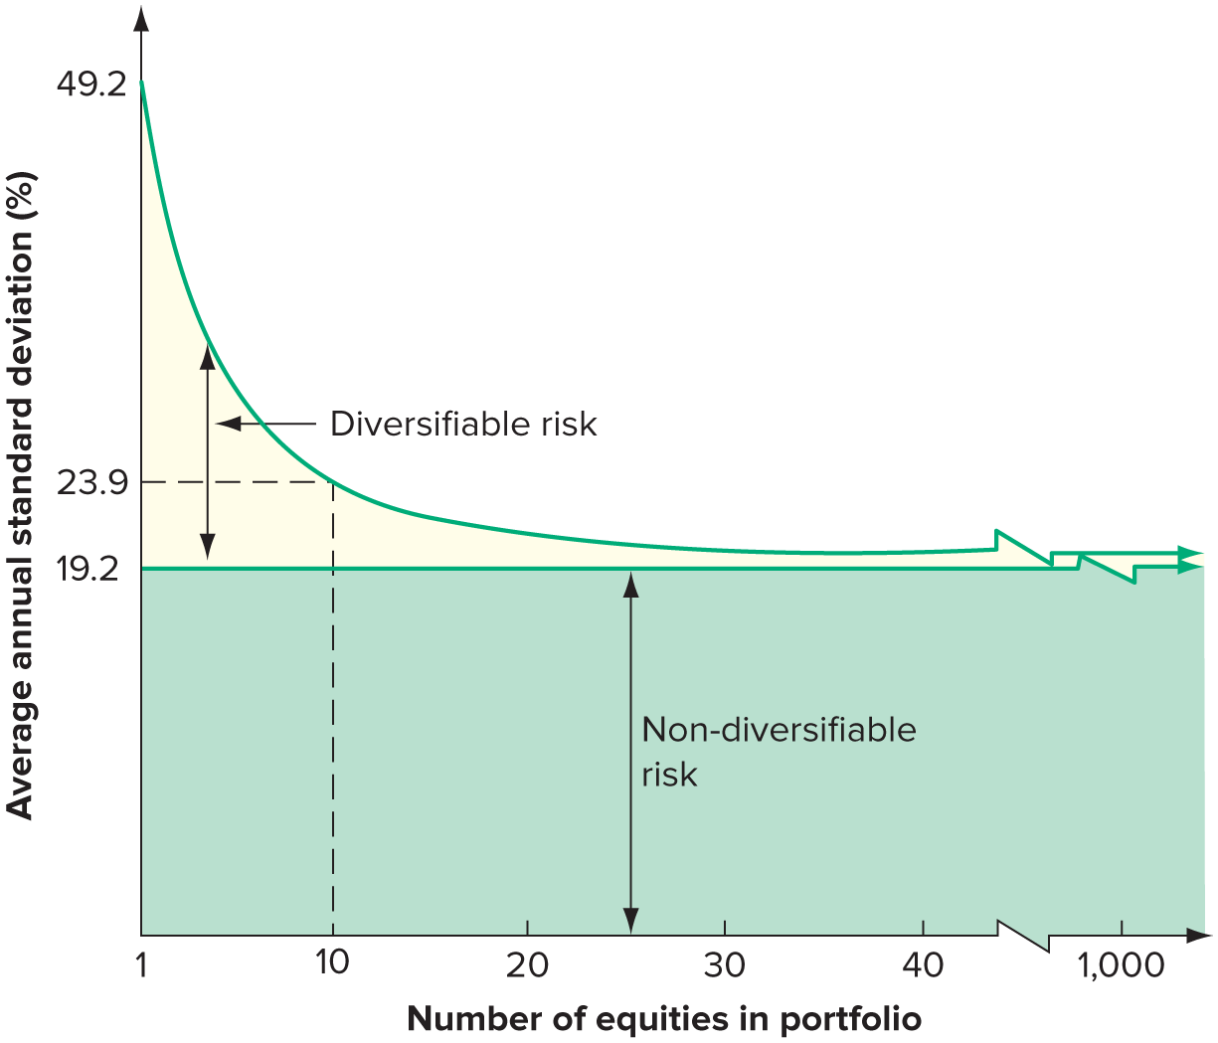
Diversifiable and Non-Diversifiable Risk

Slide 27
Diversification and Unsystematic Risk
Unsystematic risk is eliminated by diversification, so a portfolio with many assets has almost no unsystematic risk

Slide 28
Systematic and Unsystematic Risk
Systematic risk is also called non-diversifiable risk or market risk.
Unsystematic risk is also called diversifiable risk, unique risk or asset-specific risk.
For a well-diversified portfolio, the unsystematic risk is negligible.
For such a portfolio, essentially all of the risk is systematic.

Slide 29
Diversification an Systematic Risk
The total risk of an investment, as measured by the standard deviation of its return, can be written as:
Total risk = Systematic risk + Unsystematic risk

Slide 30
Systematic Risk and Beta

Slide 31
Definitions
Terms
The Systematic Risk Principle
The expected return on a risky asset depends only on that asset’s systematic risk.
The Beta Coefficient
The amount of systematic risk present in a particular risky asset relative to that in an average risky asset.

Slide 32
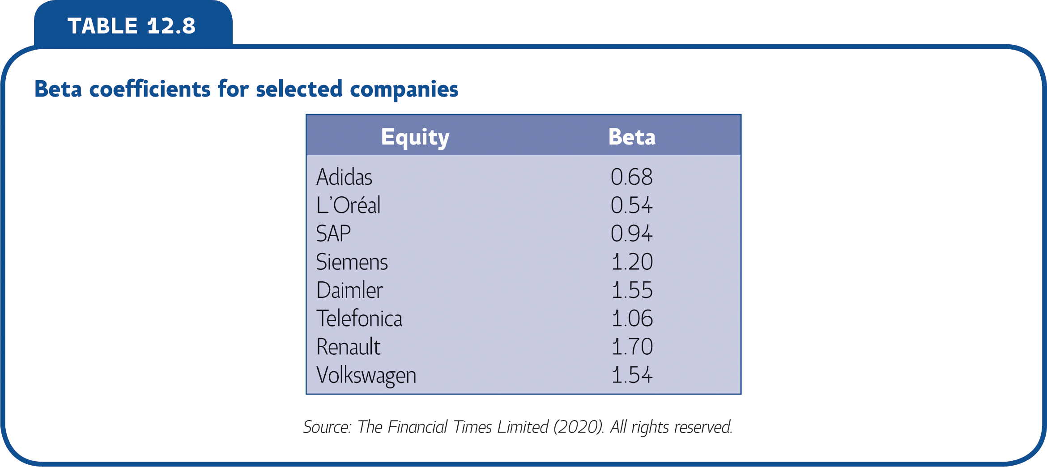

Slide 33
Portfolio Betas
where w = portfolio weight
β_{P} = w_{x} β_{x} + w_{y} β_{y}

Slide 34
The Security Market Line

Slide 35
The Security Market Line Example
Consider a portfolio made up of:
Asset A, and
A risk-free asset.
We can calculate some different possible portfolio expected returns and betas by varying the percentages invested in these two assets.

Slide 36
The Security Market Line Example
Percentage of portfolio in Asset A (%) | Portfolio expected return (%) | Portfolio beta
0 | 8 | 0.0
25 | 11 | 0.4
50 | 14 | 0.8
75 | 17 | 1.2
100 | 20 | 1.6
125 | 23 | 2.0
150 | 26 | 2.4

Slide 37
Reward to Risk Ratio
In equilibrium, the reward-to-risk ratio must be the same for all the assets in the market

Slide 38
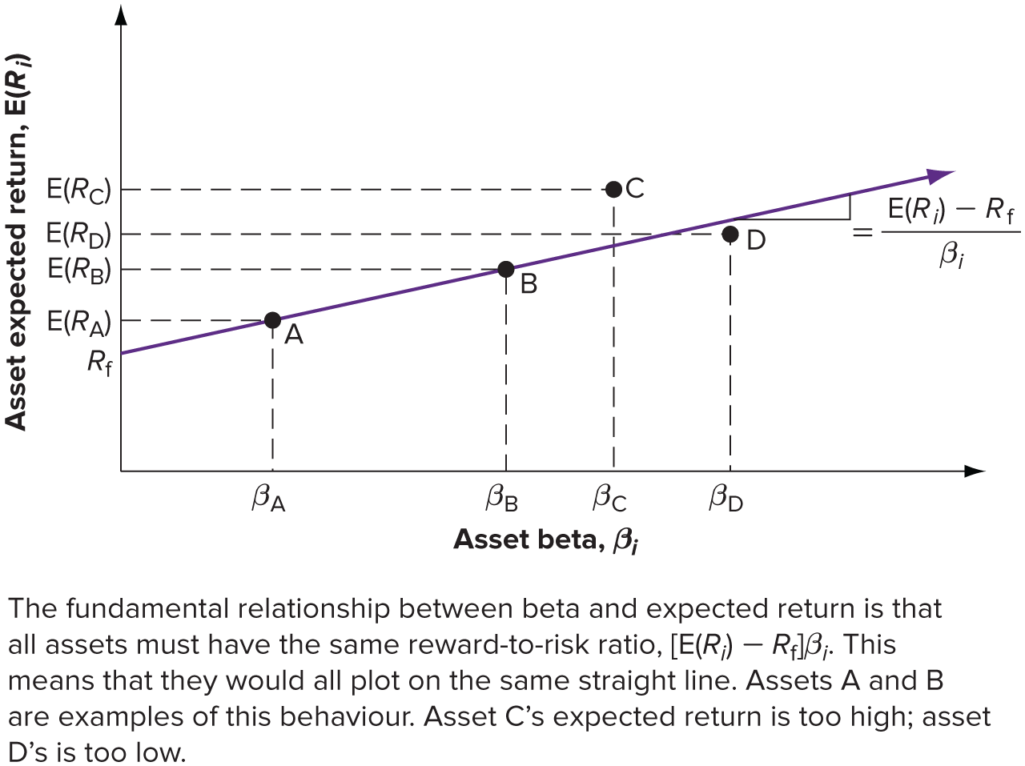
The Security Market Line: Graphical Presentation

Slide 39
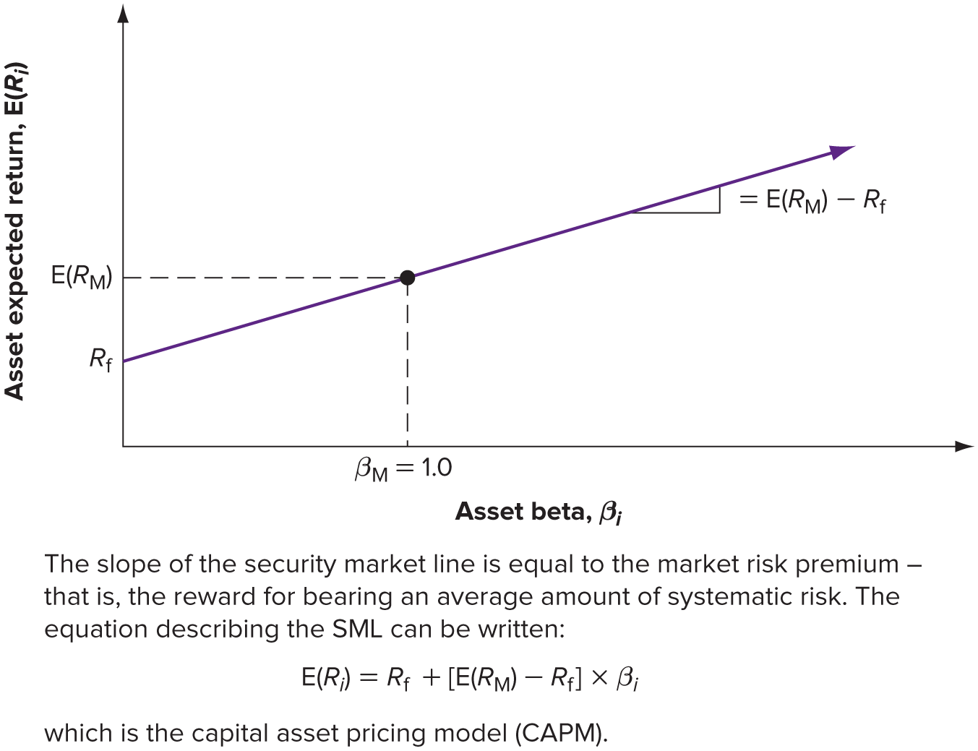
The Security Market Line: Graphical Presentation

Slide 40
The Capital Asset Pricing Model
The Security Market Line
A positively sloped straight line displaying the relationship between expected return and beta.
Market Risk Premium
The slope of the SML – the difference between the expected return on a market portfolio and the risk-free rate.
Capital Asset Pricing Model (CAPM)
The equation of the SML showing the relationship between expected return and beta
E(R_{i}) = R_{f} + [E(R_{M}) - R_{f}] x β_{i.}

Slide 41
Capital Asset Pricing Model Assumptions
CAPM – The expected return for a particular asset depends on three things
The pure time value of money: As measured by the risk-free rate, R_{f}, this is the reward for merely waiting for your money, without taking any risk.
The reward for bearing systematic risk: As measured by the market risk premium, E(R_{M}) – R_{f}, this component is the reward the market offers for bearing an average amount of systematic risk in addition to waiting.
The amount of systematic risk: As measured by β_{i}, this is the amount of systematic risk present in a particular asset or portfolio, relative to that in an average asset.

Slide 42
The SML and The Cost of Capital

Slide 43
The Cost of Capital
Cost of Capital
The minimum required return on a new investment

Slide 44
Concept Quiz

Slide 45
How do we calculate the expected return on a security and the variance of this expected return?
What is the principle of diversification? Why is some risk diversifiable and some risk not?
What is the fundamental relationship between risk and return in a well-functioning market?

